Slide 1
COVID-19 Statistics
05-04-2020

Slide 2
Latest Statistics
(updated 05-04-2020)
Total confirmed cases worldwide: 1,271,394
74,710 new cases (6% increase)
Total fatal cases worldwide: 69,361
4,768 new fatalities (7% increase)
Israel recorded 8,430 cases in total
increased by 579 cases (7% increase)
18.0# in confirmed cases, 38.0# in mortality
19.0# in cases per capita, 39.0# in mortality rate

Slide 3
Latest Statistics
(updated 05-04-2020)
Worldwide mortality rate: 5.5% (+0.1%)
Israel mortality rate: 0.6% (+0.0%)
US has most cases in total (337,072)
Italy has most fatal cases in total (US)
US recorded the most new cases (28,222)
US recorded the most new fatal cases (1,212)

Slide 4
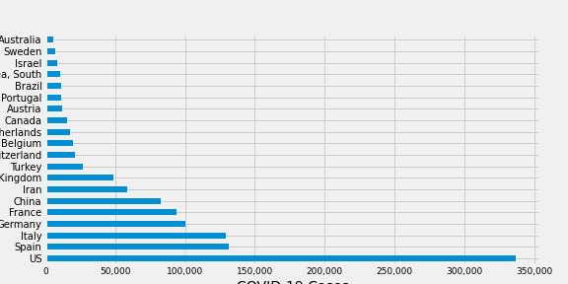
Top 20 countries by number of confirmed COVID-19 cases

Slide 5
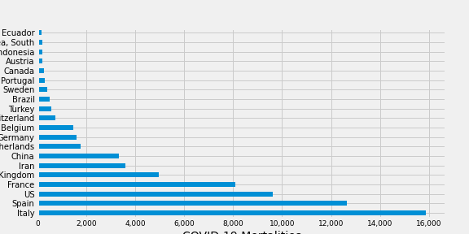
Top 20 countries by number of deathes caused by COVID-19

Slide 6
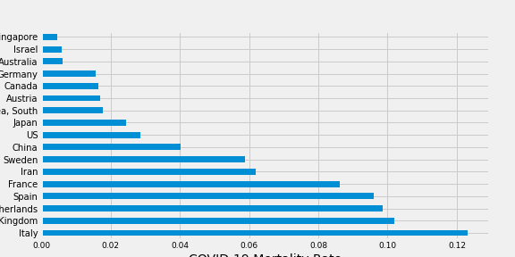
COVID-19 Mortality Rate
Selected Countries

Slide 7
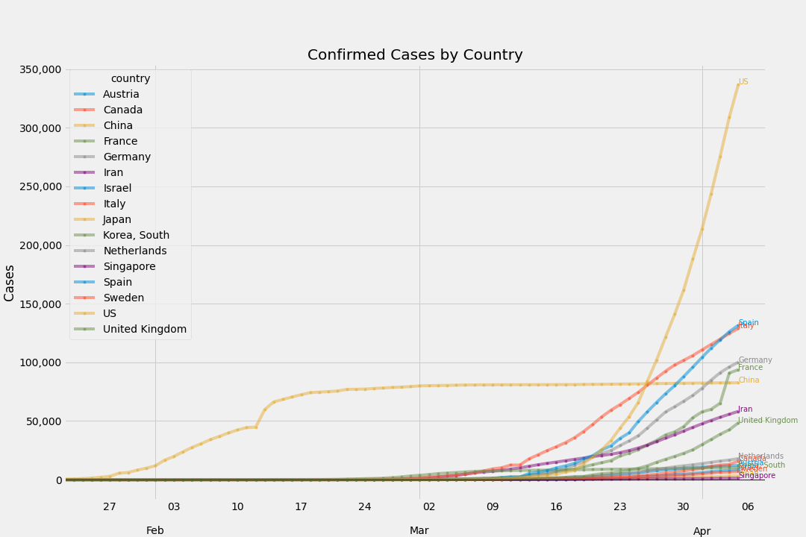
Total Confirmed Cases
By Country

Slide 8
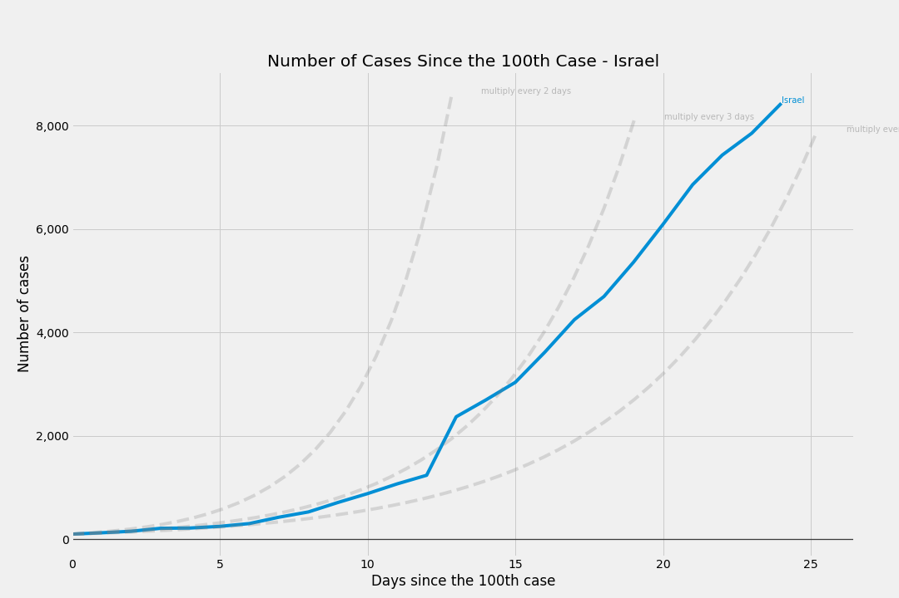
# of cases
Since the 100th case - Israel

Slide 9
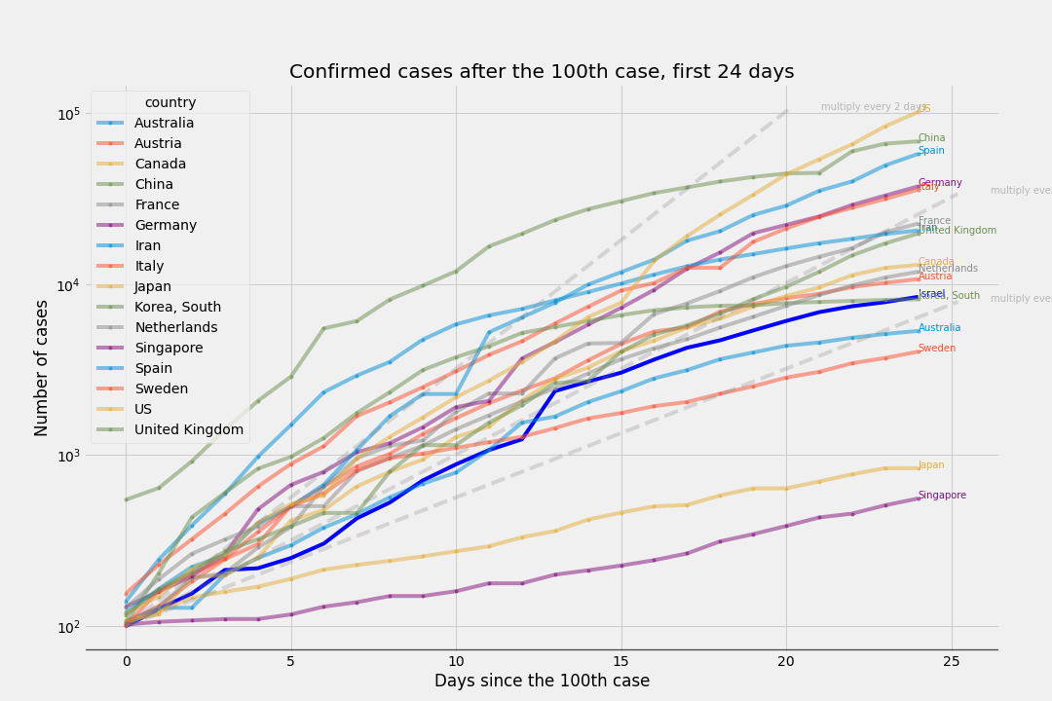
# of cases
Since the 100th case - Israel's timeline

Slide 10
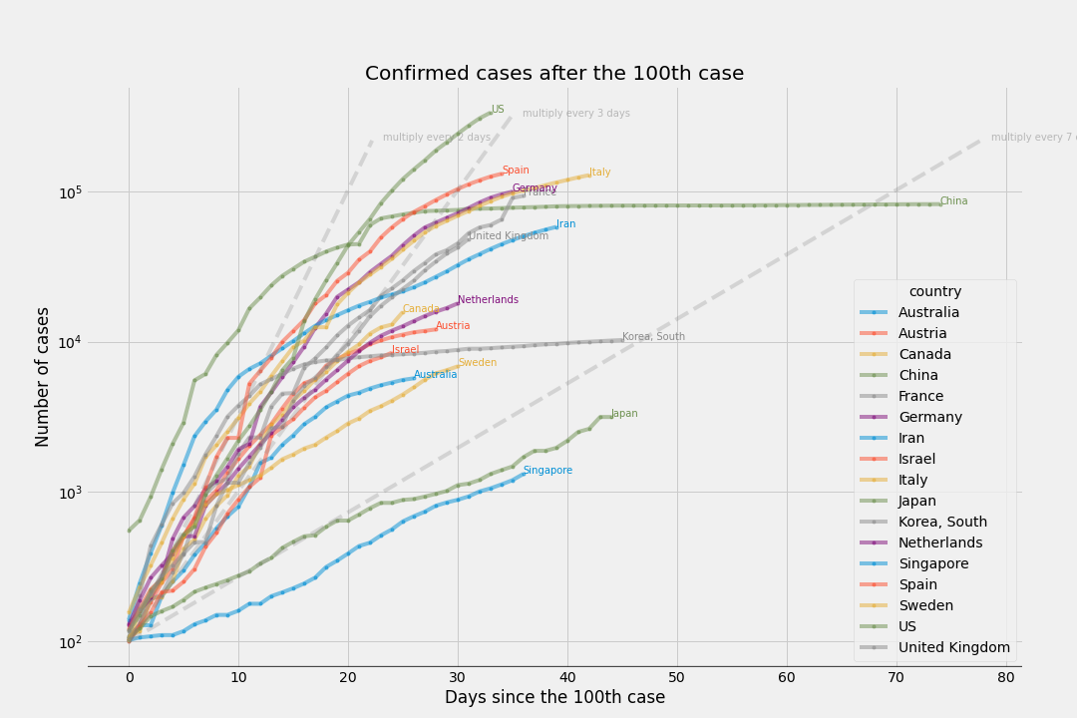
# of cases
Since the 100th case

Slide 11
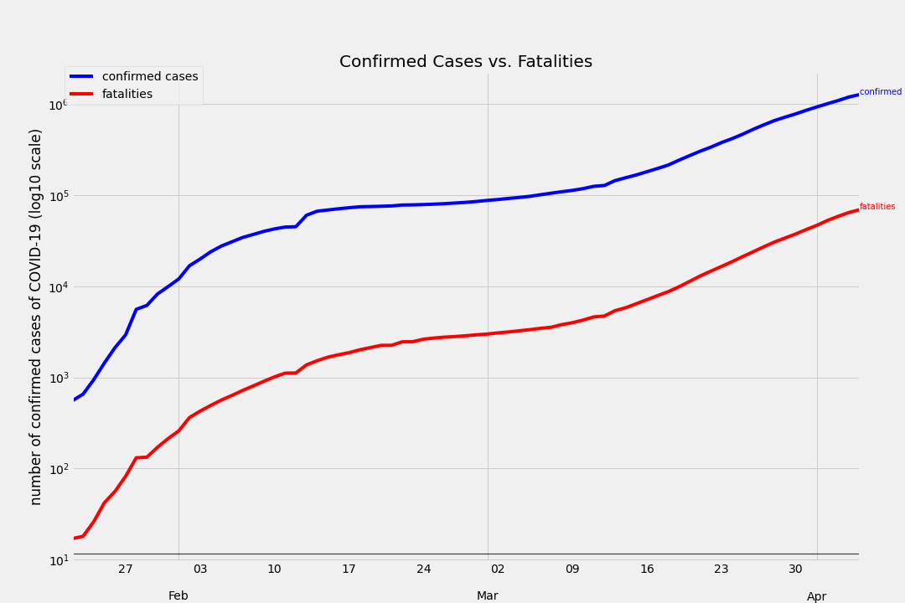
COVID-19 confirmed cases vs COVID-10 fatalities

Slide 12
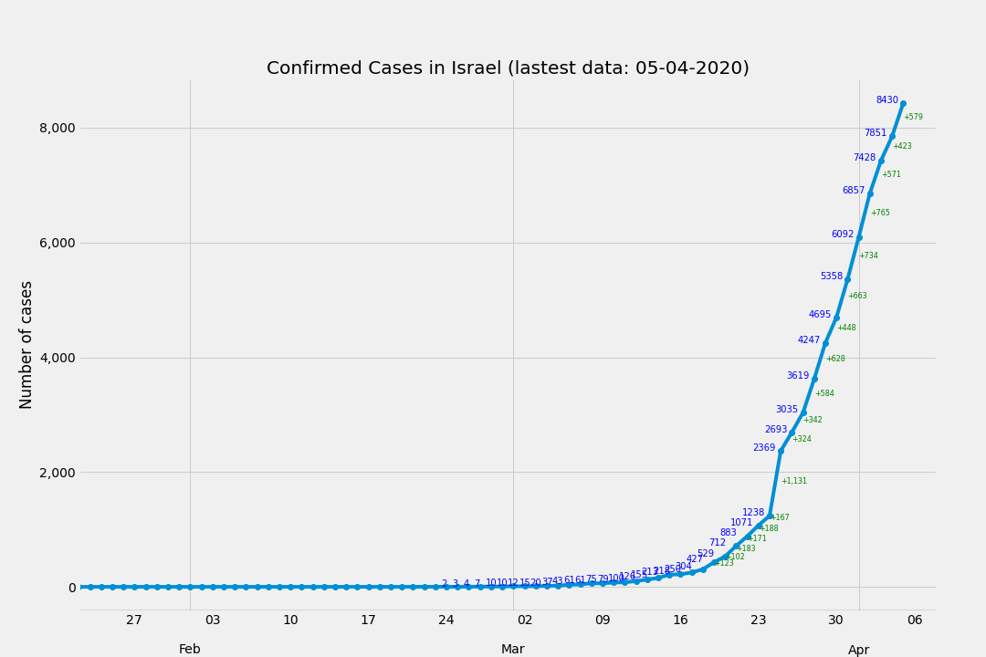
Confirmed Cases in Israel
(latest data2020-04-05 00:00:00)

Slide 13
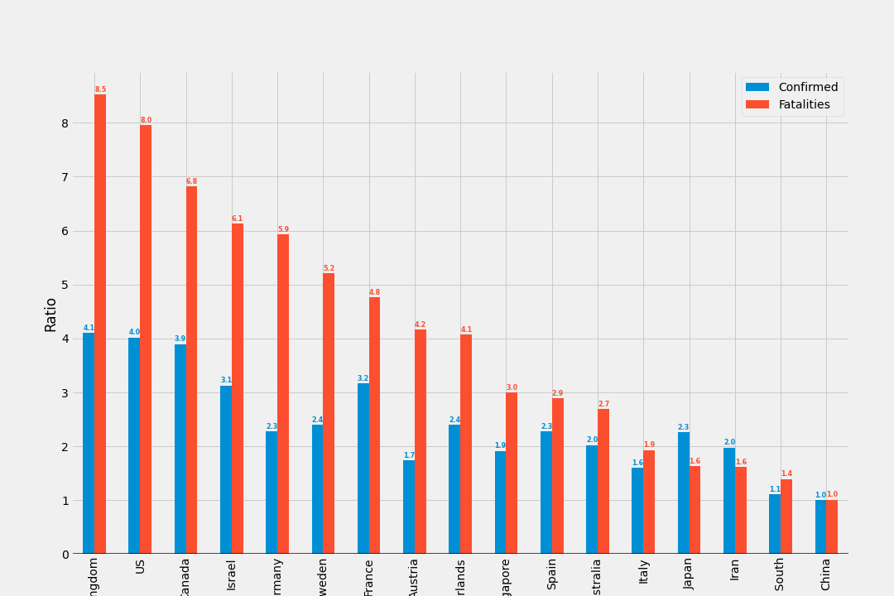
Ratio between today and 10 days ago
Confirmed cases and deaths

Slide 14
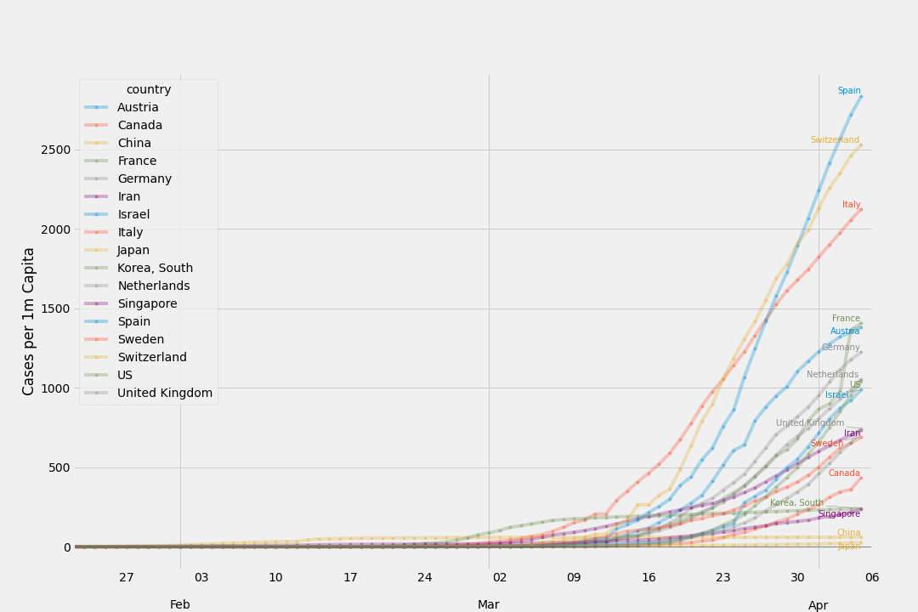
Confirmed Cases by Country
per 1,000,000 ppl

Slide 15
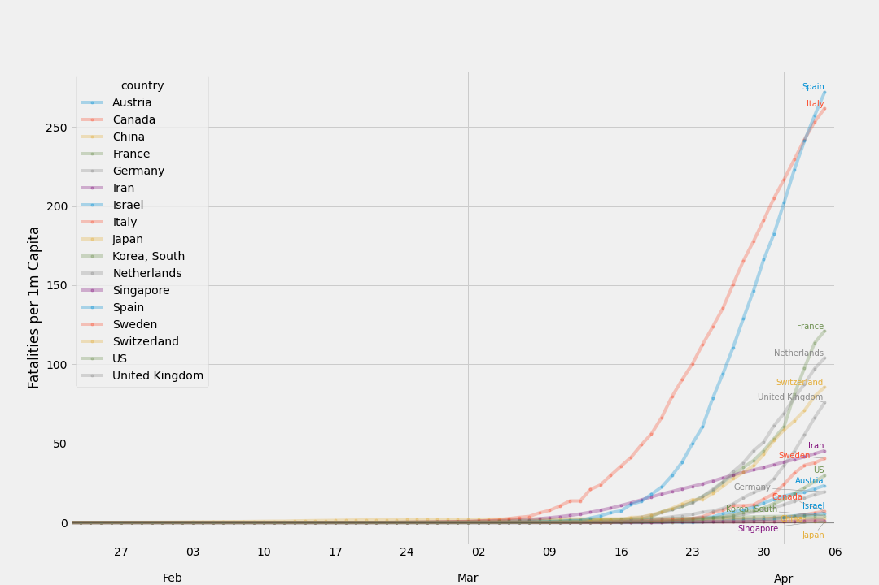
Fatal Cases by Country
per 1,000,000 ppl

Slide 16
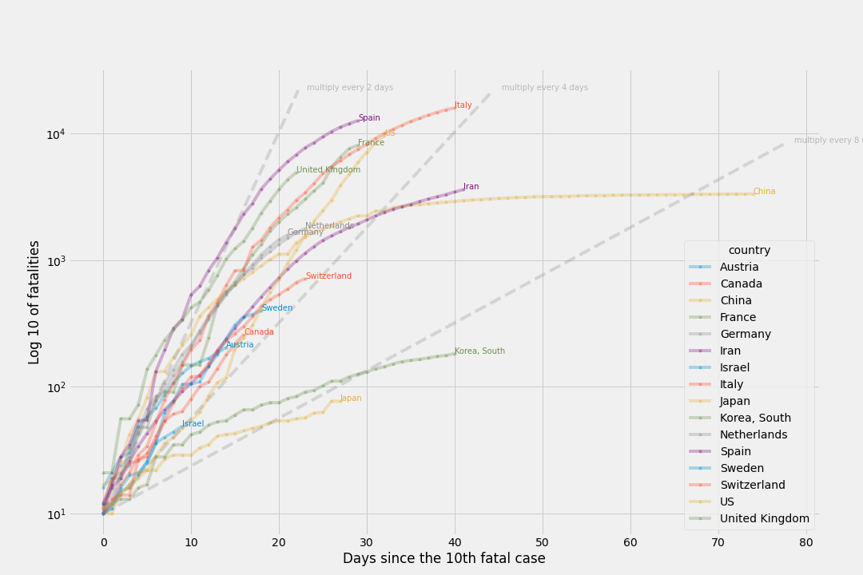
Fatal cases
Since the 10th fatality

Slide 17
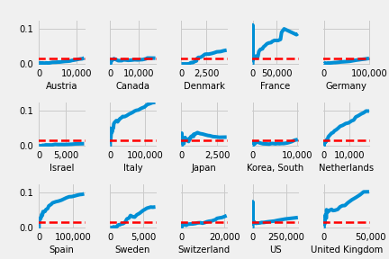
Incrasing number of cases vs mortality rate
Red Line - 1.5% mortality

Slide 18
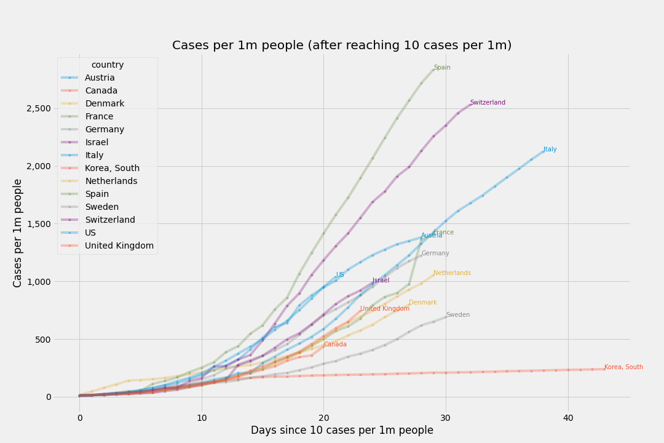
Cases per 1m people
after reaching 10 cases per 1m

Slide 19
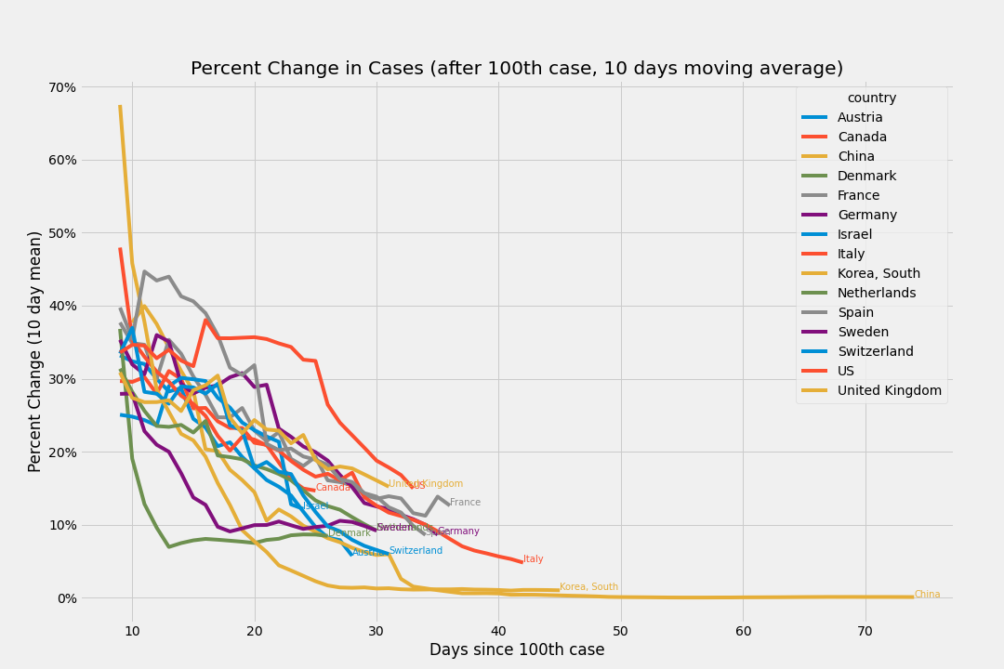
Percent Change in Cases
after 100th case, 10 days moving average

Slide 20
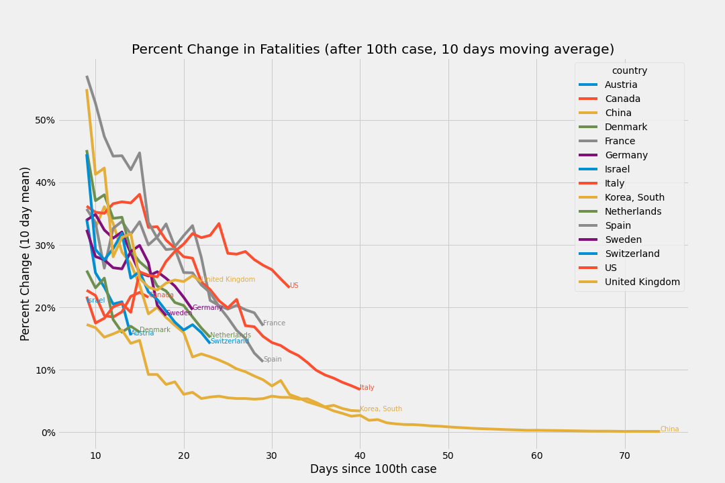
Percent Change in Fatalities
after 100th case, 10 days moving average

Slide 21
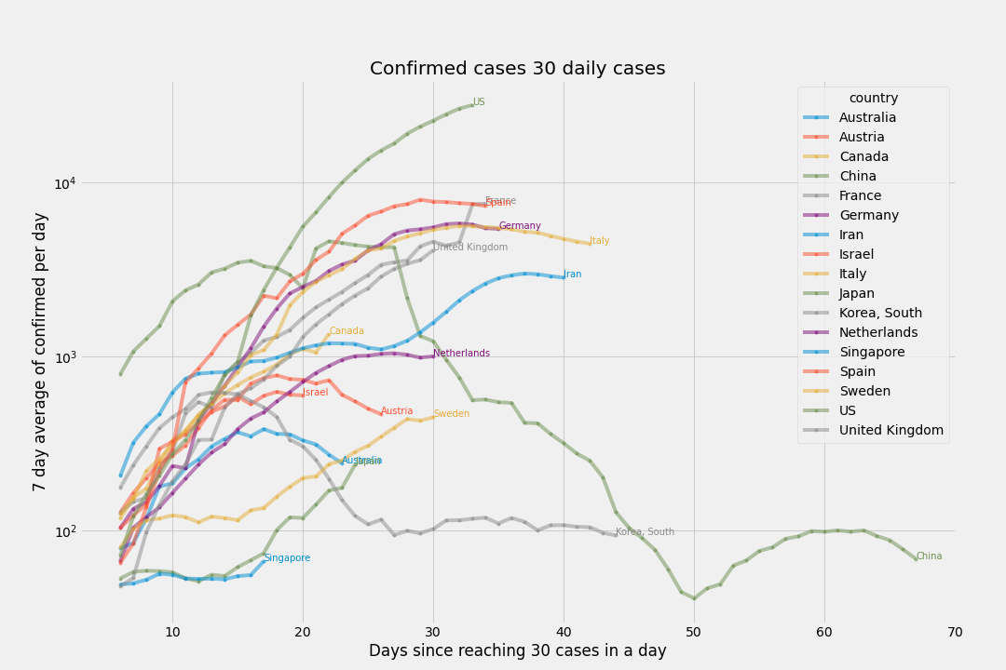
# of deaths per day
Since 3 deaths (7 day moving average)

Slide 22
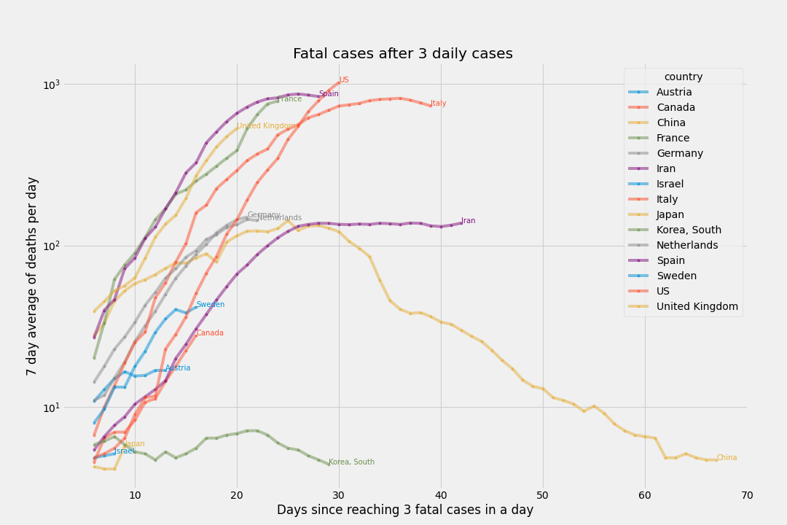
# of deaths per day
Since 3 deaths (7 day moving average)

Slide 23
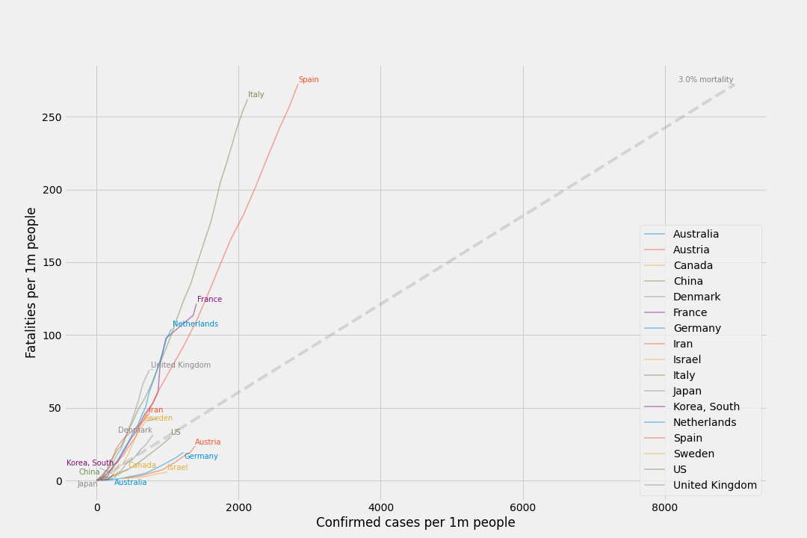
Cases per capita and Mortality per capita
Using 3% mortality rate as reference

